Slide 1
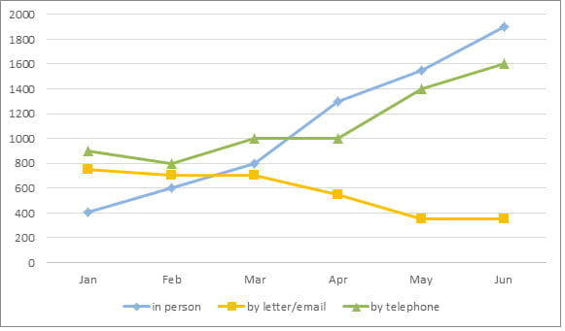
LINE GRAPH

Slide 2
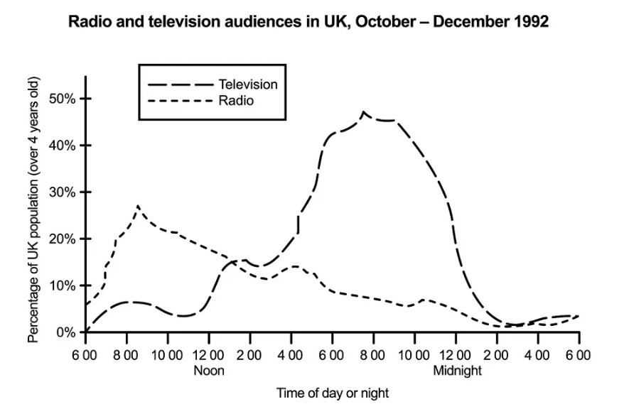
The graph shows radio and television audiences throughout the day in 1992.
Summarise the information by selecting and reporting the main features, and make comparisons where relevant.
Write at least 150 words.

Slide 3
ANSWER
The line graph illustrates the proportion of people in the UK who watched television and listened to the radio over 24 hours from October to December 1992. Overall, a significantly greater percentage of the television audience watched in the evening while radio had the most listeners in the morning. Over the course of each day and night, more people watched television than listened to the radio.
Less than 10% of people watched television between 1 am and 12 noon but at 4 pm this figure increased rapidly, reaching a peak of almost half the population at 8 pm. After this, the graph records a sharp decline in viewers, reaching a low of only a tiny percentage by 3 am.
Radio, on the other hand, shows a very different trend. The most popular time for listeners to be tuned in was just after 8 am when around 27% of the population was listening. After a brief peak, the numbers dropped steadily to barely 2%, apart from fluctuations at around 4 pm and 10.30 pm. The percentage of listeners remained low overnight before beginning a rapid ascent from 6am to the 8 am high.
(198 words)

Slide 4
BREAKDOWN AND EXPLANATION

Slide 5
Line Graph
Before we begin, here’s a model essay structure that you can use as a guideline for all IELTS Academic Task 1 questions.
Ideally, your writing should have 3 paragraphs:
Paragraph 1 – Introduction+Overview
Paragraph 2 – 1st main feature
Paragraph 3 – 2nd main feature

Slide 6
Analyse the question
The graph shows radio and television audiences throughout the day in 1992.
Summarise the information by selecting and reporting the main features, and make comparisons where relevant.

Slide 7
The graph below shows radio and television audiences throughout the day in 1992.
Summarise the information by selecting and reporting the main features, and make comparisons where relevant.
Write at least 150 words.
Every question consists of:
Sentence 1 – A brief description of the graphic
Sentence 2 – The instructions
The graphic – chart, graph, table, etc.
Sentence 2 tells you what you have to do.
You must do 3 things:
1. Select the main features.
2. Write about the main features.
3. Compare the main features.

Slide 8
Identify the Main Features
What information do the 2 axes give?
What are the units of measurements?
What are the time periods?
What can you learn from the title and any labels?
What is the most obvious trend?
Are there any notable similarities?

Slide 9
Identify the Main Features
Main feature 1: The peak time for television audiences is in the evening (8 pm).
Main feature 2: The peak time for radio audiences is in the morning (8 am).

Slide 10
Write an Introduction
Question:
The graph below shows radio and television audiences throughout the day in 1992.
Introduction (Paragraph 1):
The line graph illustrates the proportion of people in the UK who watched television and listened to the radio over 24 hours from October to December 1992.
DO NOT GIVE ANY HEADING
THE HEADINGS OF THE PARAGRAPHS ARE FOR EXPLANATION ONLY
YOUR WRITING SHOULD ONLY HAVE PARAGRAPHS AS SHOWN IN THE LAST SLIDE

Slide 11
Write an Overview
.
Main feature 1: The peak time for television audiences is in the evening (8 pm).
Main feature 2: The peak time for radio audiences is in the morning (8 am).
Overview (Paragraph 1):
Overall, a significantly greater percentage of the television audience watched in the evening while radio had the most listeners in the morning. Over the course of each day and night, more people watched television than listened to the radio.
DO NOT GIVE ANY HEADING
THE HEADINGS OF THE PARAGRAPHS ARE FOR EXPLANATION ONLY
YOUR WRITING SHOULD ONLY HAVE PARAGRAPHS AS SHOWN IN THE LAST SLIDE

Slide 12
Paragraph-1 (Intro+Overview)
The line graph illustrates the proportion of people in the UK who watched television and listened to the radio over 24 hours from October to December 1992. Overall, a significantly greater percentage of the television audience watched in the evening while radio had the most listeners in the morning. Over the course of each day and night, more people watched television than listened to the radio.
DO NOT GIVE ANY HEADING
THE HEADINGS OF THE PARAGRAPHS ARE FOR EXPLANATION ONLY
YOUR WRITING SHOULD ONLY HAVE PARAGRAPHS AS SHOWN IN THE LAST SLIDE

Slide 13
Write the 1st Detail Paragraph
Here is our first main feature again:
Main feature 1: The peak time for television audiences is in the evening (8 pm).
And this is an example of what you could write:
Paragraph 2:
Less than 10% of people watched television between 1 am and 12 noon but at 4 pm this figure increased rapidly, reaching a peak of almost half the population at 8 pm. After this, the graph records a sharp decline in viewers, reaching a low of only a tiny percentage by 3 am.
DO NOT GIVE ANY HEADING
THE HEADINGS OF THE PARAGRAPHS ARE FOR EXPLANATION ONLY
YOUR WRITING SHOULD ONLY HAVE PARAGRAPHS AS SHOWN IN THE LAST SLIDE

Slide 14
Write the 2nd Detail Paragraph
For the fourth and final paragraph, you do the same thing for your second key feature.
Main feature 2: The peak time for radio audiences is in the morning (8 am).
Here’s an example of what you could write:
Paragraph 3:
Radio, on the other hand, shows a very different trend. The most popular time for listeners to be tuned in was just after 8 am when around 27% of the population was listening. After a brief peak, the numbers dropped steadily to barely 2%, apart from fluctuations at around 4 pm and 10.30 pm. The percentage of listeners remained low overnight before beginning a rapid ascent from 6am to the 8 am high.
*Ascent-rise
DO NOT GIVE ANY HEADING
THE HEADINGS OF THE PARAGRAPHS ARE FOR EXPLANATION ONLY
YOUR WRITING SHOULD ONLY HAVE PARAGRAPHS AS SHOWN IN THE LAST SLIDE

Slide 15
ANSWER
The line graph illustrates the proportion of people in the UK who watched television and listened to the radio over 24 hours from October to December 1992. Overall, a significantly greater percentage of the television audience watched in the evening while radio had the most listeners in the morning. Over the course of each day and night, more people watched television than listened to the radio.
Less than 10% of people watched television between 1 am and 12 noon but at 4 pm this figure increased rapidly, reaching a peak of almost half the population at 8 pm. After this, the graph records a sharp decline in viewers, reaching a low of only a tiny percentage by 3 am.
Radio, on the other hand, shows a very different trend. The most popular time for listeners to be tuned in was just after 8 am when around 27% of the population was listening. After a brief peak, the numbers dropped steadily to barely 2%, apart from fluctuations at around 4 pm and 10.30 pm. The percentage of listeners remained low overnight before beginning a rapid ascent from 6am to the 8 am high.
(198 words)

